Slide 1
Parallel K-means Clustering using Multiple Data Partitioning Techniques and Dynamic Load Balancing
-AYUSH JAIN
CS52500-jain207@purdue.edu

Slide 2
PROBLEM DESCRIPTION -SCOPE
K-means clustering iteratively performs two major steps: data assignment and calculating the relocation of mean points. (centroid)
The data assignment step sends each data point to a cluster with closest mean, or centroid. Normally, the measure of closeness is the Euclidean distance. On clustering large datasets, the k-means method spends most of its execution time on computing distances between all data points and existing centroids.
Since distance computation of one data point is irrelevant to others. Therefore, data parallelism can be achieved in this case and it is the main focus of this project.
A tradeoff between approximate K-means and computational cost in parallel environment is also explored.
The clustering has been implemented using OpenMPI for all the experiments on 8-core mc cluster.

Slide 3
FORMAL PROBLEM DESCRIPTION
K-Means clustering involves 3 basic parameters as mentioned below:
Number of clusters (k)
Number of features/attributes per data point (f)
Number of Datapoints/ Sample Size (n)
2 data partitioning techniques are explored– a) equal sized partition among processors and b) Partitioning of data points based on values along a particular dimension
The idea is to see the effectiveness of these parallel strategies for cases when n>>k or f~k or small k for K-means in terms of performance using optimized communication patterns in MPI.
Number of processors (p) are also varied for a dataset with fixed (k,f,n) to see the affect of data partitioning over parallel execution and bring down the computational complexity of k-means which is O(nkt), where n is the number of data points or objects, k is the number of desired clusters, and t is the number of iterations the algorithm takes for converging to a stable state

Slide 4
RELATED WORK
Some work is related to increase the convergence of the algorithm like Zhao et al. proposed a fast parallel K-means clustering algorithm based on MapReduce. [W. Zhao, H. Ma, Q. He, "Parallel K-Means Clustering Based on MapReduce]
Li and Fang proposed a parallel algorithm on a single instruction multiple data (SIMD) architecture. [X. Li and Z. Fang, Parallel clustering algorithms, Parallel Computing, Vol.11, Issue 3, 1989, pp. 275-290]
Tirumala Rao, Prasad and Venkateswarlu studied memory mapping performance on multi-core processors of k-means algorithm. They conducted experiments on quad-core and dual-core shared memory architecture using OpenMP and POSIX threads. [S. Tirumala Rao, E. Prasad, and N. Venkateswarlu, A critical performance study of memory mapping on multi-core processors: An experiment with k-means algorithm with large data mining data sets, International Journal of Computer Applications, Vol.1, No.9, pp. 90-98. ]
Zhang studied parallel K-Means using Master/Slave model but with static data partitioning [Zhang, X.Z., Mao, J., Ling Ou, L.: The Study of Parallel KMeans Algorithm. In: Proceedings of the 6th WCAIAC]

Slide 5
NOVELTY
Although Master/Slave configuration has been used before, but there is no work related to data partitioning along a particular dimension and then optimizing using dynamic load balancing.
The above approach along with static equal partitioning have been compared for various values of n, k,f and p. There can be many reasons for such kind of partitioning like:
If there is high variation of data points along with a particular dimension, then we can use that to pass few(not all) centroids close to all the i-th dimension values in a partition. This is because other remaining centroids will automatically be far away for that partition if there is not much variation along other dimension.
Dimensionality Reduction Techniques can be followed by such approach where top ranked vector contain maximum variation
Sometimes, batch-wise data points are added to the existing dataset which affect few centroids only. Dynamic Load balancing can play significant role in this scenario

Slide 6
NOVELTY
By partitioning dataset along a particular dimension, we can get uneven sized partitions and some processors can be idle while other processors are computing distance for data points.
In such a case, master can provide another partition to that processor for computing distances in a particular iteration.
This can be useful dataset is very large and one round of partitioning of datapoints doesn’t suffice. Remaining datapoints are retained by master and given to other processors when they finish their previous batch.

Slide 7
SEQUENTIAL K-Means Approach
Input: a set of data points and the number of clusters, K
Output: K-centroids and members of each cluster
Steps
1. Select initial centroid C = C1,C2,C3,…Ck
2. Repeat
2.1 Assign each data point to its nearest cluster center
2.2 Re-compute the cluster centers using the current cluster memberships
3. Until there is no further change in the assignment of the data points to new cluster centers (convergence)
Executed on one processor without any threads/message passing interface.

Slide 8
PARALLEL K-Means Using Equal Size Partitioning
Input: a set of data points and the number of clusters, K
Output: K-centroids and members of each cluster
Steps
1. Set initial centroids C = C1, C2, C3…..Ck
2. Partition data to P subgroups, each subgroup has equal size
3. For each P,
Create a new process
Send C to the created process for calculating distances and assigning cluster members
4. Receive cluster members of K clusters from P processes
5. Recalculate new centroids C‟
6. If significant difference(sumOfSquaredDistance(C, C‟)
Then set C to be C‟ and go back to step 2
Else stop and return C as well as cluster members

Slide 9
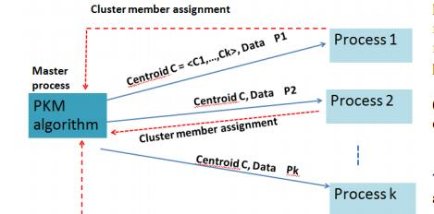
1st Approach – Parallel Data Partitioning using Equal Sized partitions
Diagram
In order to test the correctness of the algorithm, the famous 2-D Iris dataset is used to see the plot of parallel of K-means with actual clusters in scatter plot.
For emphasizing the scalability and performance of K-means, synthetic data is used that consists of randomly generated float values although results will be no different for original datasets.

Slide 10
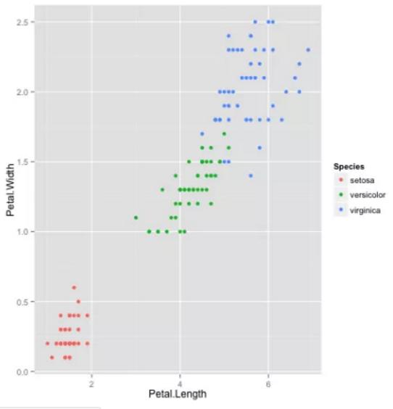
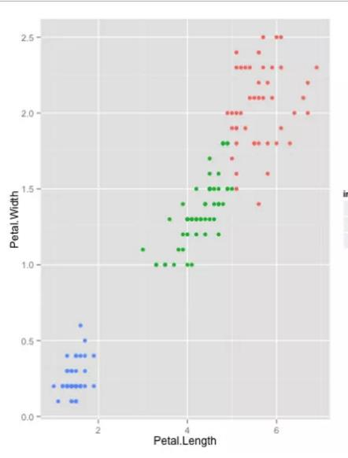
Experiment to check correctness of Parallel K-means – Original (L) vs ParallelK-means Output(R) – Similar Clusters

Slide 11
2nd approach – Data partitioning along a particular dimension and dynamic load balancing
For simplicity, 2-Dimensional dataset is used to partition data along X-Axis so that clustering effects can be seen easily.
Although machine learning techniques like PCA etc. can be applied on higher dimension data to find reduced dimension with maximum variation, the focus here is on parallel aspects of computation and load balancing technique.
Each processor except master has a threshold for the data points that it can process at a time which is equal to the 0.3*(Dataset Size/Num of Processors)
Evenly spaced Splitters are used along the dimension which is partitioned using min and max of values along that dimension across all the data points.
Thus, each partition will be of unequal sizes with maximum size of threshold for a particular processor

Slide 12
Once the computation is over for a processor, another partition can be assigned for processor till master finishes all the datapoints for a particular iteration
In the 1st parallel approach using even size data partitioning , MPI_broadcast/MPI_Reduce is used for sending/receiving centroids/distances to/from all processors as all processors will take roughly the same time in a iteration and is much more efficient than MPI_Send and MPI_Recv due to tree traversal communication.
In 2nd approach, non-blocking receiving is used at the Master process end and send/recv is used since computation time is different for each processor.

Slide 13
Experiments
N(Fixed k=5, f=20, p = 8) | Time(in sec) for ParallelKMeans – 1st approach | Time(in sec) for ParallelKMeans – 2nd approach
10000 | 2.189 | 1.432
100000 | 3.590 | 3.817
500000 | 7.037 | 14.387
1000000 | 9.987 | 31.34
5000000 | 44.559 | 64.586
1000000 | 71.160 | 102.34
From the above table, we can see that for higher dimension, 2nd approach doesn’t have much benefit over 1st when data significantly varies over multiple dimensions and there is significant overhead of splitting and load balancing

Slide 14
K(Fixed f=2,n =1million, p=8) | Time (in sec) for Sequential K-Means | Time(in sec) for ParallelKMeans – 1st approach | Time(in sec) for ParallelKMeans – 2nd approach
3 | 2.277634 | 0.986592 | 1.400077
5 | 3.079901 | 3.014080 | 1.853496
10 | 10.700578 | 4.456723 | 3.456723
50 | 39.323235 | 17.25575 | 10.456723
100 | 67.123477 | 21.139948 | 16.139948
1000 | 300.93839 | 79.983281 | 67.3983
The advantage of 2nd approach is seen over 1st parallel approach here when synthetic data is used where variation is along X-axis and partition is made along that dimension – as distance computation is reduced by sending only few centroids and not all

Slide 15
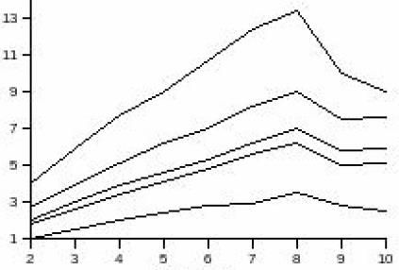
Speedup for different K and p
Horizontal Axis – Number of processors
Vertical Axis – Speedup
Lowermost to Topmost curve for K=5,7,9,11,13

Slide 16
Implementation Details
The source code folder consists of pkmeans.c(1st approach), loadpkmeans.c (2nd approach) and README containing OpenMPI compilation and execution commands
2-D iris and Image segmentation data is also present which was used to test the correctness of the parallel K-means algorithm
There is no separate file for serial k-means as pkmeans.c was used for the same.
The execution command takes number of processors and number of instances, number of features & k(clusters) as command line arguments for synthetic data experiments.
The output of parallel k-means gives sum of squared distance of each point with it’s centroid after each iteration showing it’s convergence.
At the end, time elapsed is also given as output.

Slide 17
CONCLUSION
Thus, it can be deduced that parallel K-means has significant advantages over serial algorithm especially for high dimensional large dataset size.
Also, it can be seen that 2nd new approach can be effective when exclusive memory of each processor is low and dataset is of specific type where there is variation along certain dimensions only.
Dynamic Load balancing reduces the idle time at each iteration increasing the efficiency of the system.
For future work, approximate K-means clustering algorithm can also be used with the above parallel approaches to further increase the speed of clustering

